Slide 1







PRODUCT BENDERS (GROUP 2)
Fan Wu
Shubham Bargal
Harish Sasidaran
Ishika Singh Chandel
Zohaib Sheik
YouTube
Fan
Shubham
Harish
Ishika
Zohaib

Slide 2











Table of Contents
Feb 2005
2006
YouTube Beginnings
$1.65M
Product Roadmap
“Broadcast Yourself.” 2M+ views/day
Innovation & Disruptive Innovation
Marketing Strategy
No user-friendly platforms
Value Creation
Halftime show controversy
Stickiness
Market Types
“Tune in, Hook Up”
Uberization
Critical Appreciation

Slide 3



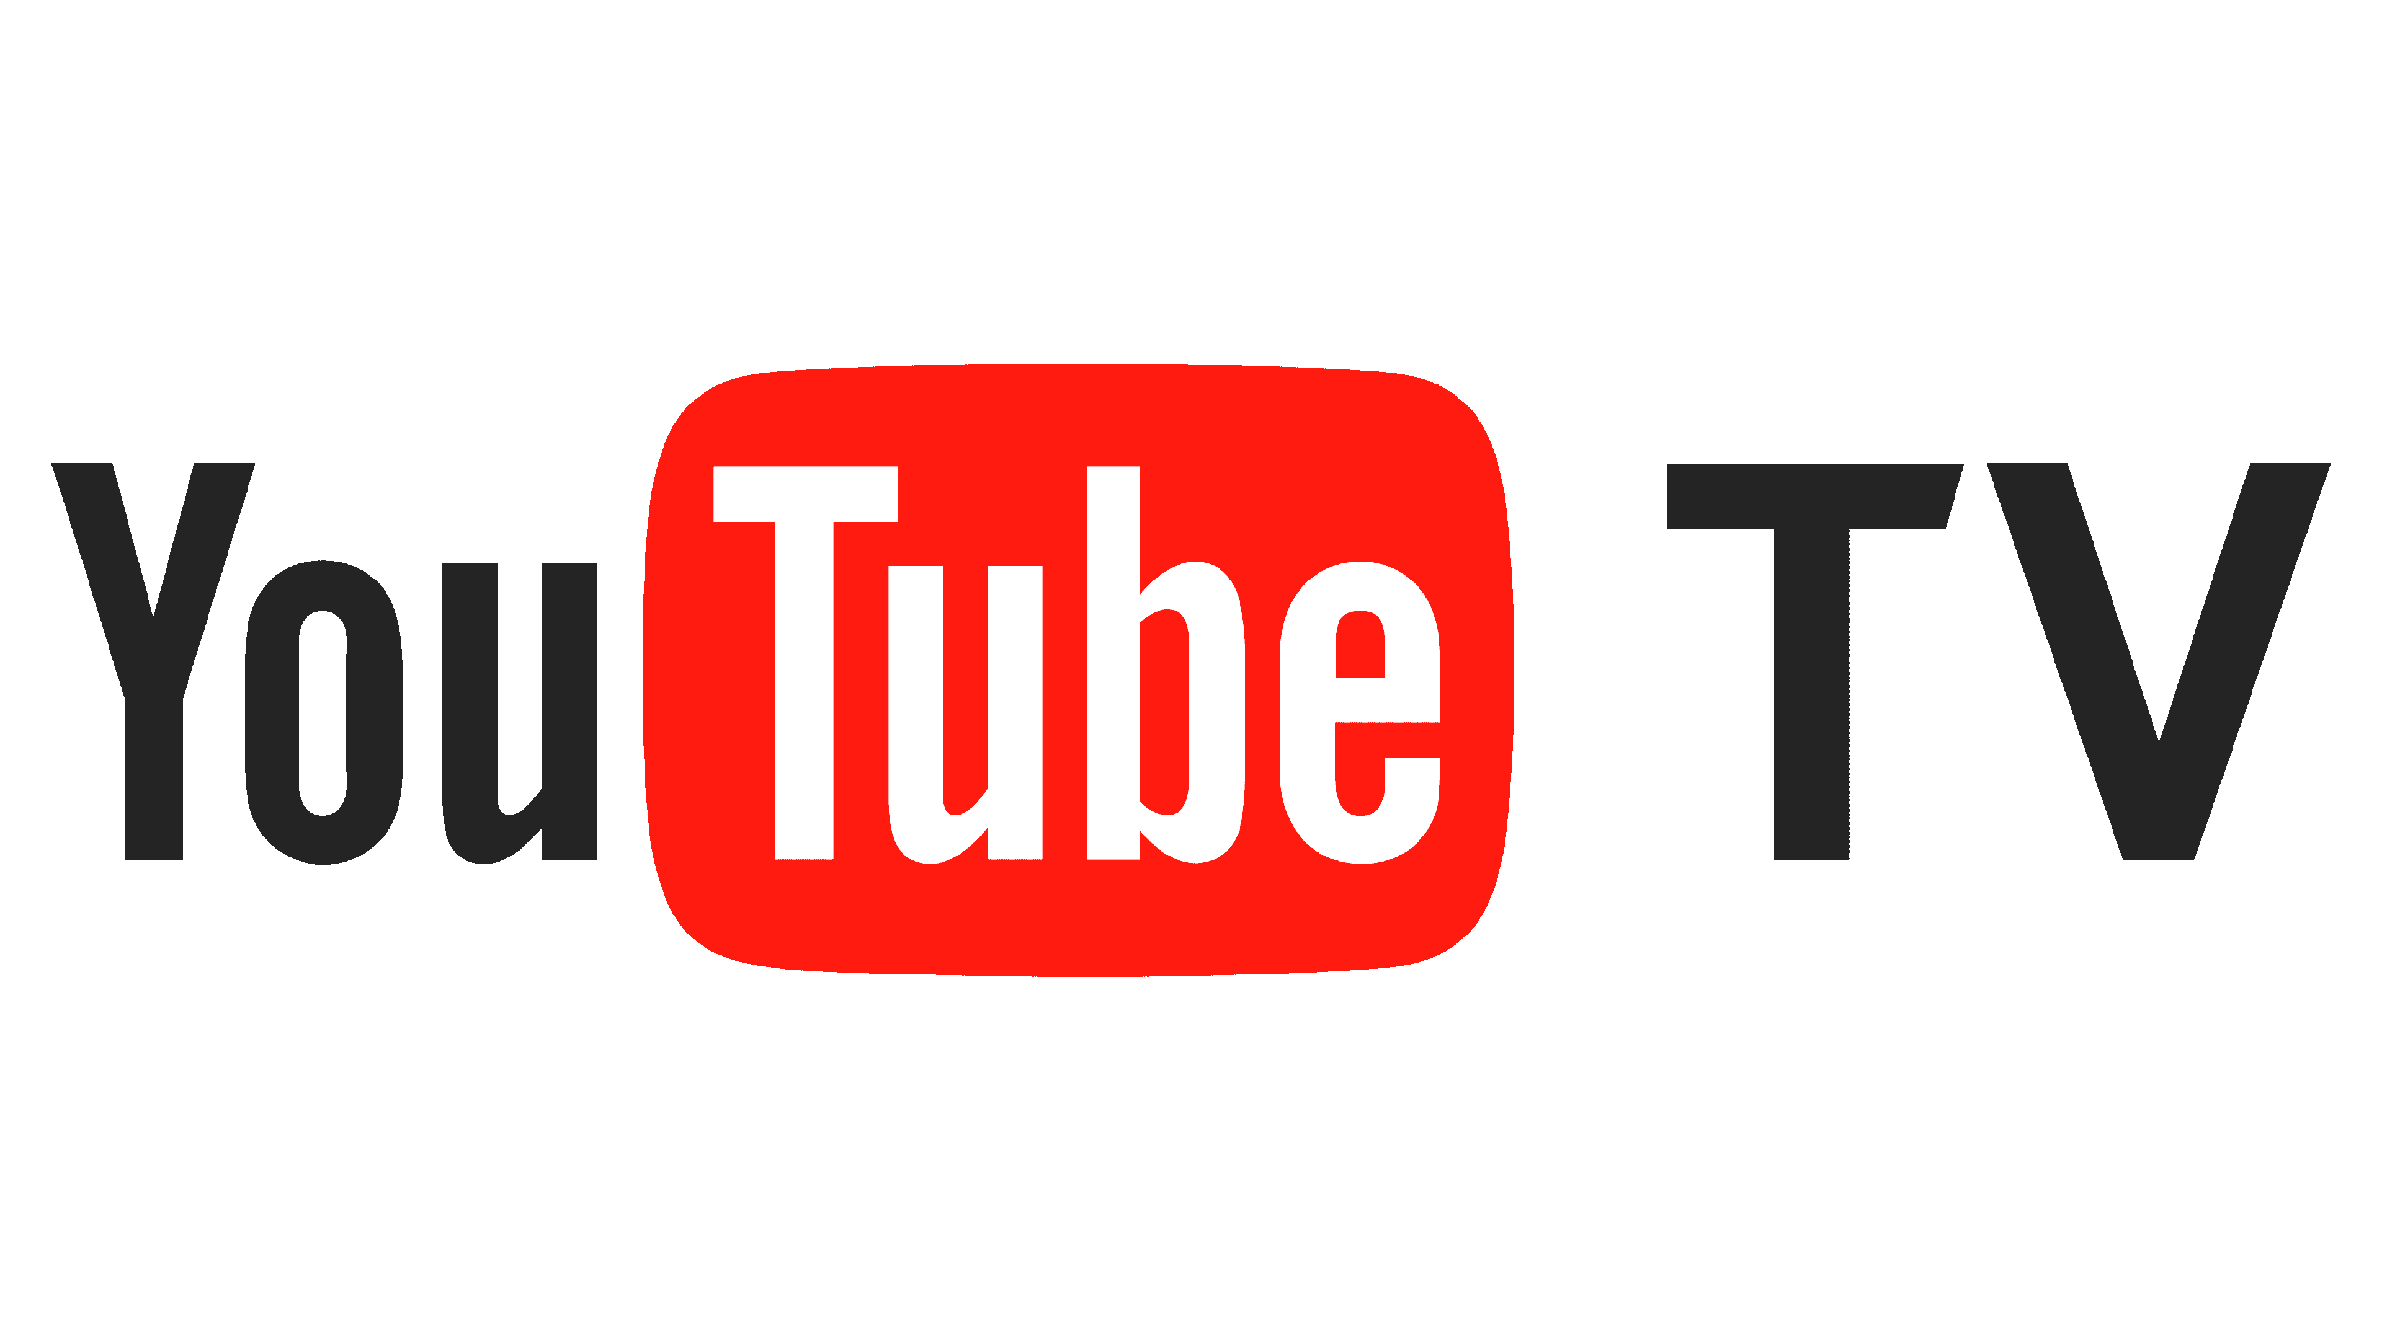
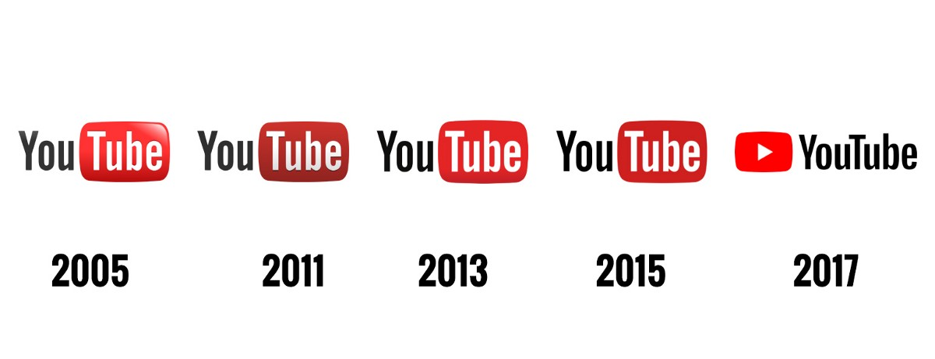
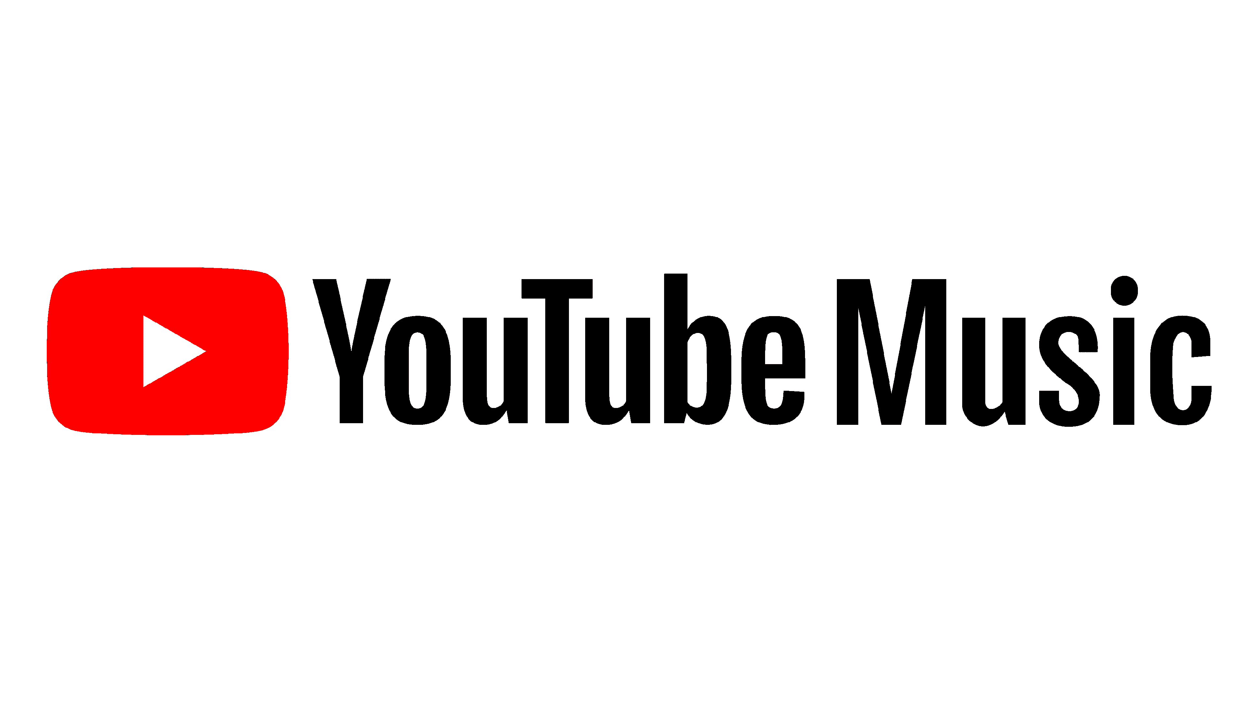

YouTube
PRODUCT ROADMAP
2006
2011
2012
2018
2018
2024
Features
Features
Video Uploading
Video Discovery and Interaction
Partner Program
Monetization
Added “Related Videos”
YouTube Live
YouTube Algorithm
Video Uploading
Video Discovery and Interaction
Partner Program
Monetization
Added “Related Videos”
YouTube Live
YouTube Algorithm
Creator Studio
Kids App
Super Chat
Premium Launch
Story
VR
YouTube TV
YouTube Music
Creator Studio
Kids App
Super Chat
Premium Launch
Story
VR
YouTube TV
YouTube Music
Shorts
Sound Video & Creative Effects
360-Degree Video Support
VR Rooms
Parental Control functions
Native 4K HDR
Hyper Smart Device Integration
Shorts
Sound Video & Creative Effects
360-Degree Video Support
VR Rooms
Parental Control functions
Native 4K HDR
Hyper Smart Device Integration
Milestones
Milestones
Signs contracts for original content
Next news network acquisition
Signs contracts for original content
Next news network acquisition
Vidmaker, Subarctic Band Page Acquisition
4k Video Support
Spaces Launched
1B Monthly Users
Vidmaker, subarctic band page acquisition
4k video support
Spaces launched
1B monthly users
Additional 50B daily views
SimSim Acquisition for E-commerce in India
230.6 M Active monthly users
5.5 M paid subscribers
Additional 50 B daily views
SimSim acquisition for E-commerce in India
230.6M active monthly users
5.5 M paid subscribers
Impacts
Impacts
48 hrs of videos uploaded/ minute
5.2 hrs per viewer/month
48 hrs of videos uploaded/ minute
5.2 hrs per viewer/month
YouTube Creator Award
YouTube Creator Academy
Algorithm Revised for Stricter Policies
YouTube Crossed $15B Revenue
Creator award
Creator academy
Algorithm revised for stricter policies
Reaches $15B revenue
$8B revenue
Increased Parental supervision
Realtime user interactions
34% market share in vMVPDS market
$8B revenue
Increased parental supervision
Realtime user interactions
34% market share in vMVPDS market

Slide 4
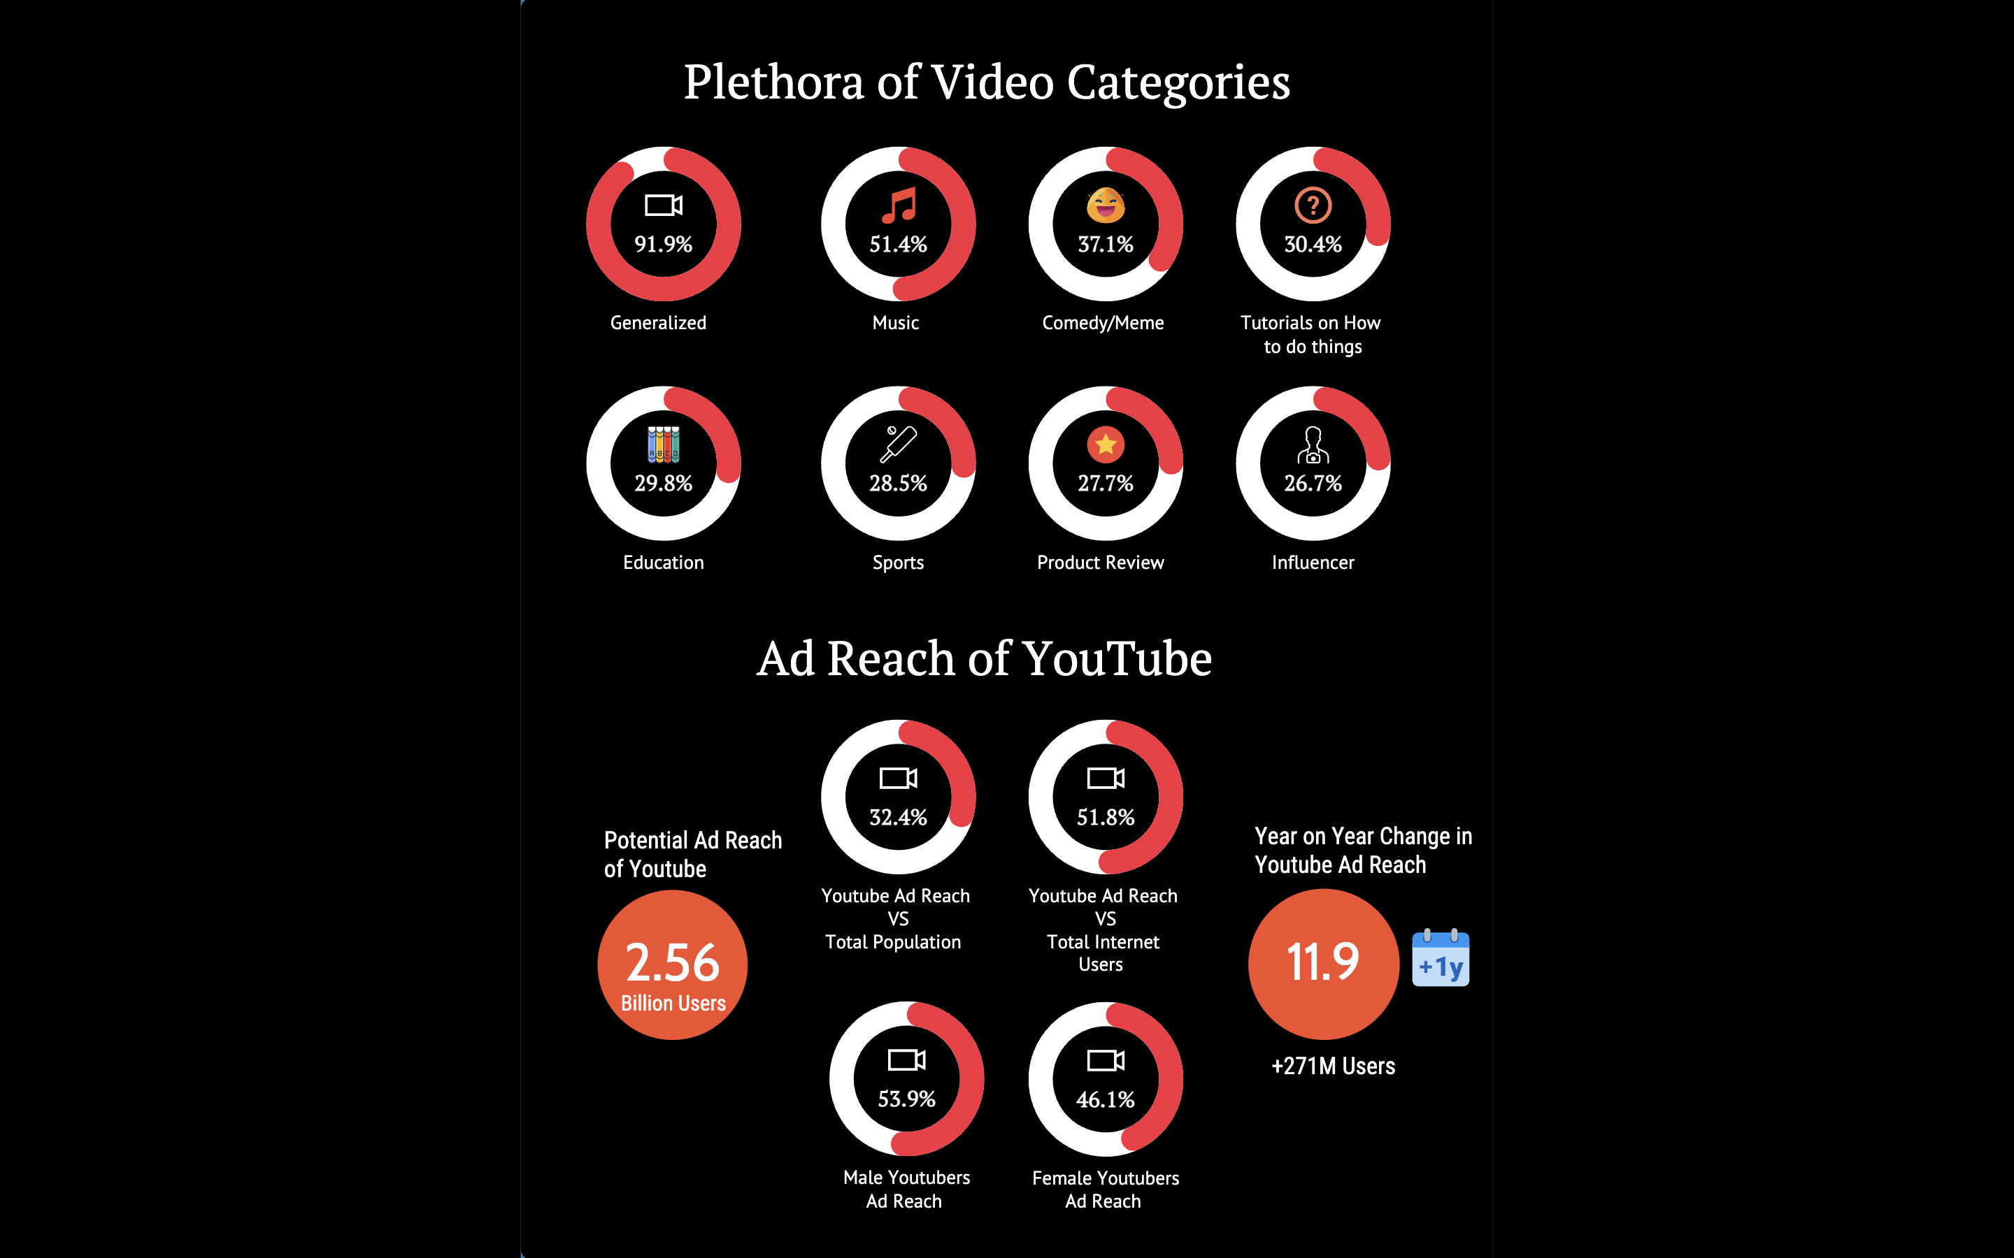







YouTube
INNOVATION & DISRUPTIVE INNOVATION
INNOVATION
PLETHORA OF PROFILED CONTENT CATEGORIES
User-generated Content
Location & globalization
Native advertising platform
New business model
DISRUPTIVE INNOVATION
AD REACH OF YouTube
Disruption of traditional way of television broadcasting
Monetization
Democratization of media

Slide 5
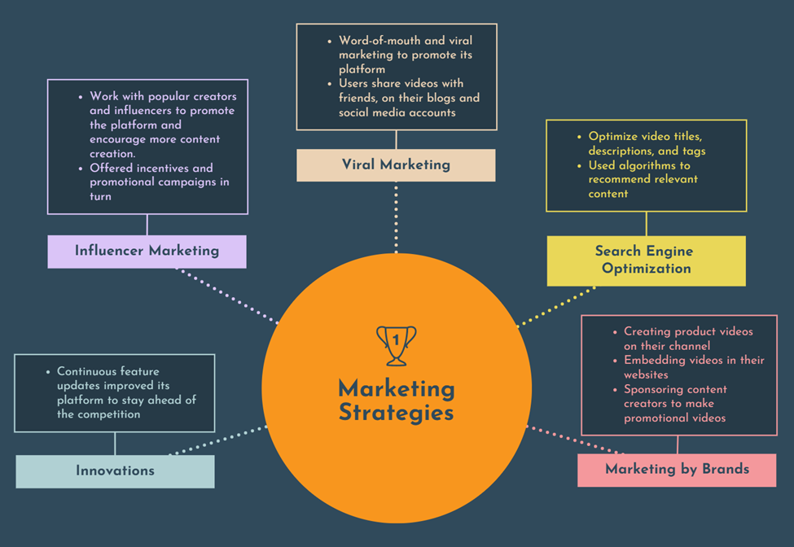





YouTube
MARKETING STRATEGY
Viral Marketing
Search Engine
Optimization
Influencer Marketing
Innovations
Marketing by Brands

Slide 6

YouTube
VALUE CREATION
Users
2 Billion Viewers daily (Second largest)
70% of YouTube viewers use the platform to solve a problem related to their work, studies, or hobbies.
User → Search & Viewing habits → Algorithm → 70% Time spent
Space to soft launch Business
YouTube partner program → advertising revenue → Monetization (Increased by 40% Yearly)
Global recognition, community engagement, and Brand Sponsorships
YouTube Analytics
In Q3 2021, → $30 billion (Over 3 years)
Creators
Stake
holders
YouTube →major source of revenue for Google (Q3 2023 → $7.2 billion in advertising revenue, → 83% 2022)
In Q3 2021, YouTube → 54% increase in the number of advertisers running TrueView for action ads

Slide 7


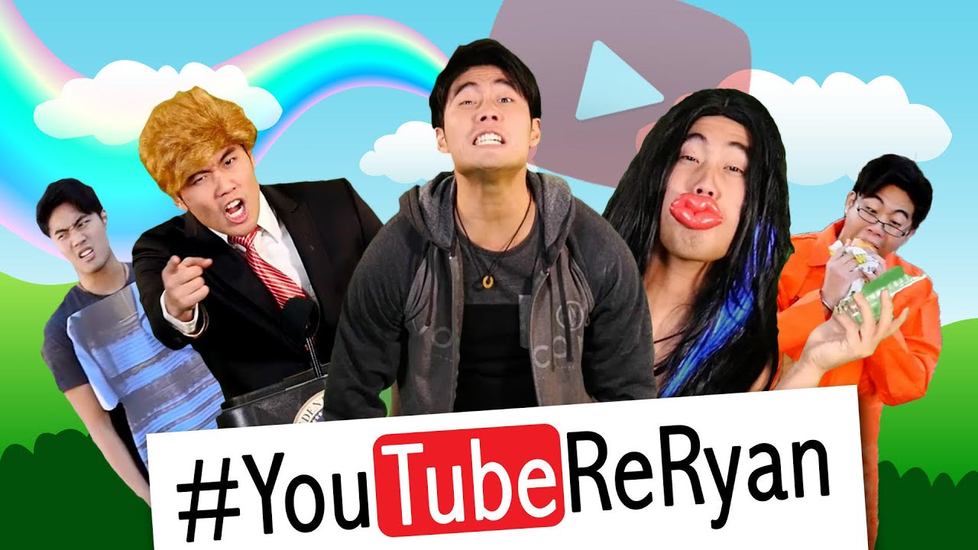


STICKINESS
Why do viewers keep coming back to YouTube?
I would never use YouTube
I only use YouTube
You find out there’s a semi-famous content creator at a neighboring school
YouTube vids go viral (2006)
Integration into every part of life!
YouTube awards => competitive market
Attached sentiment leads to lifetime customer loyalty
No platform compares to how user-friendly it is
Upload school projects
Tutorials
TV shows & dramas
Trends
Music playlists
Live stream
Short videos
$4B revenue (2014)
YouTube's Market Share Is 20 Times Its Nearest Competitor (Richmond, 2011)
This is how much the top earning channel makes: $4.9M (2014)
1.8B users by 2018 (“YouTube Usage Statistics”)
Notes:
YouTube understands its core competency is the content provided by creators!
Viral marketing & influencer marketing
It’s now a part of every day life. YouTube continues to innovate
YouTube awards create its own capital market
Diversifies content

Slide 8









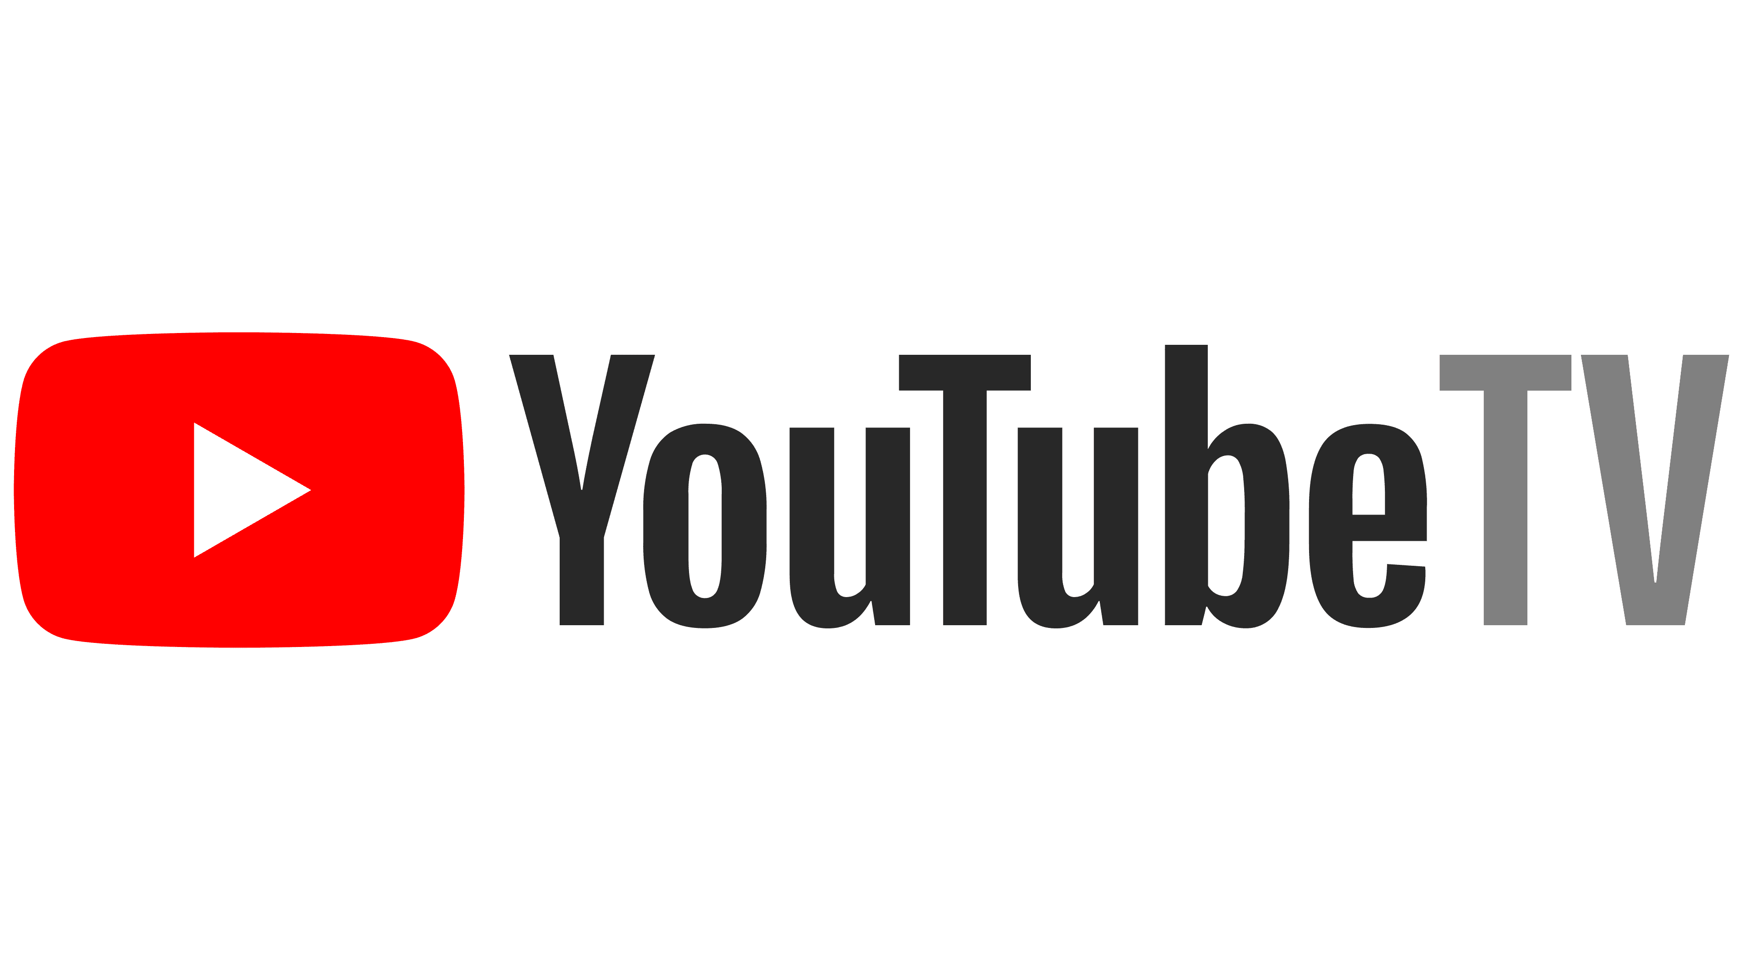
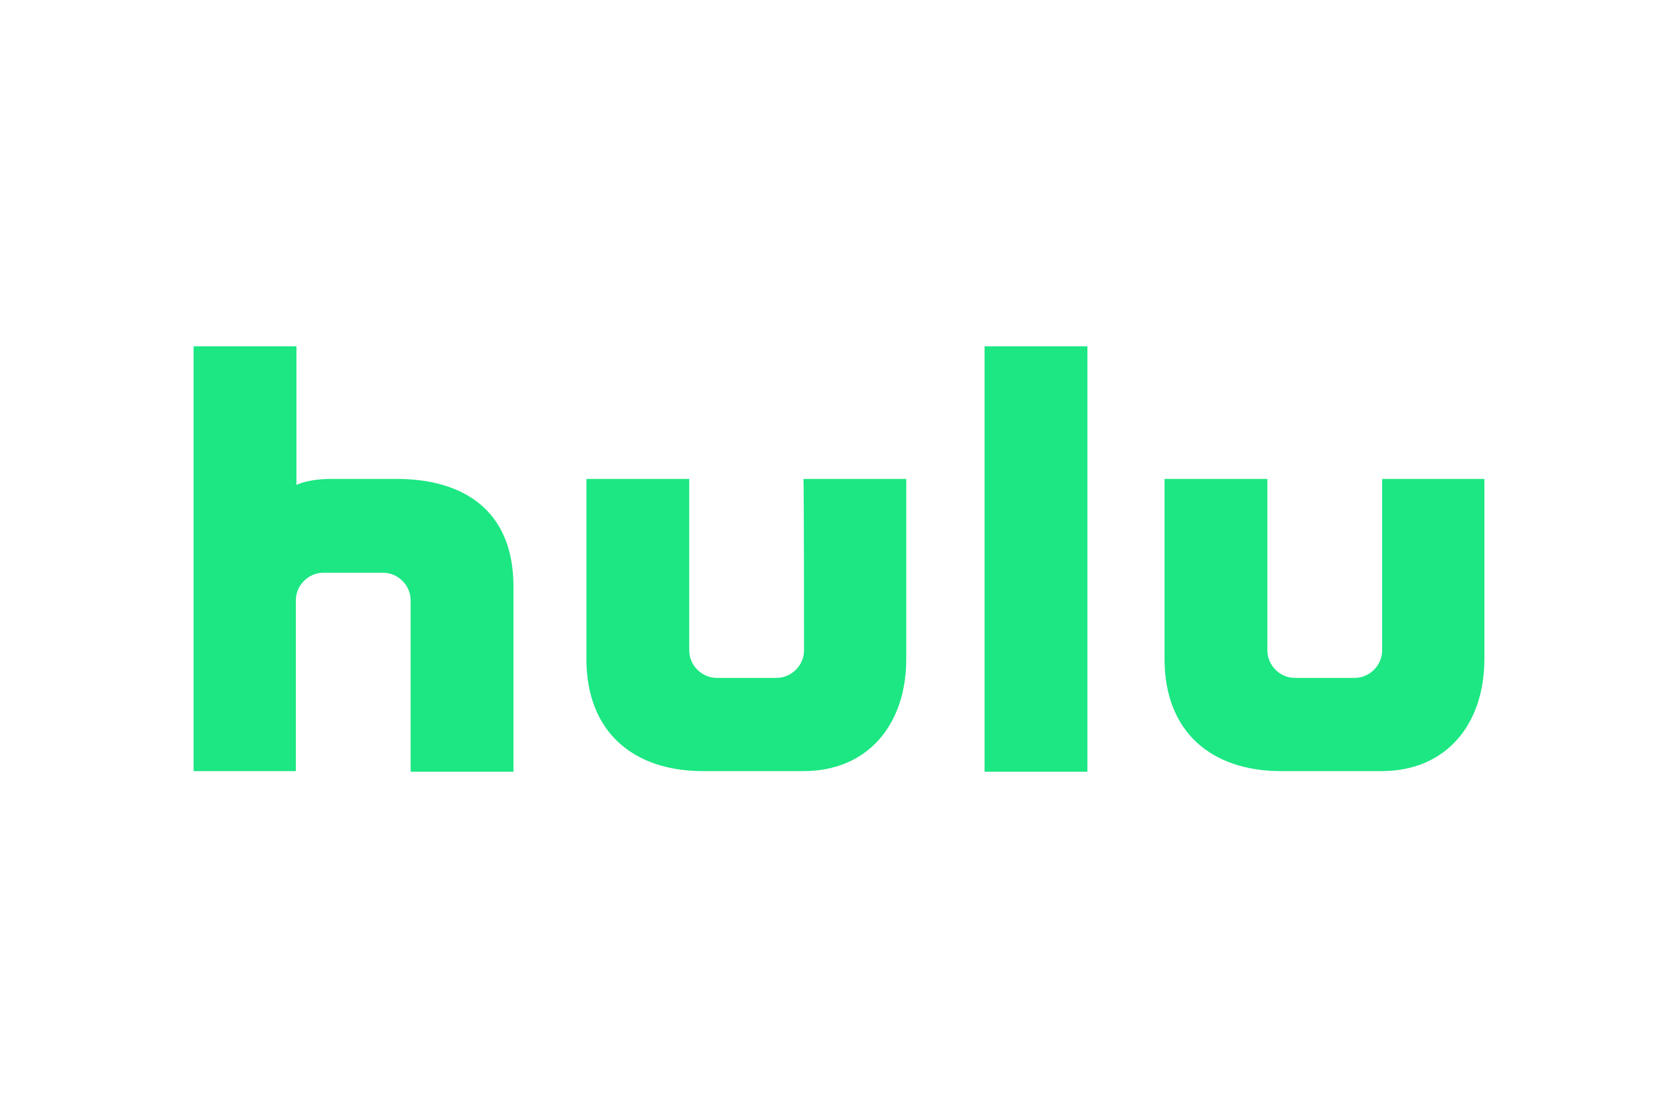





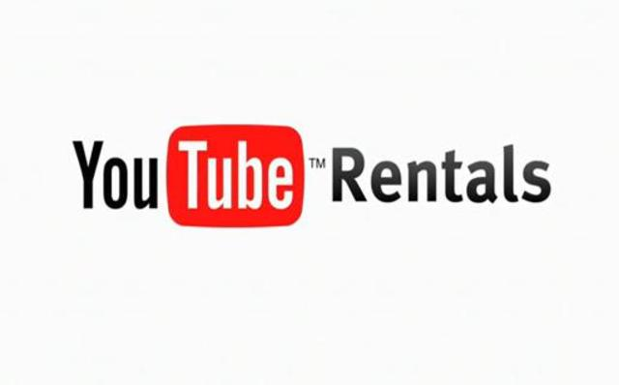














MARKET TYPES
Horizontal Competition
Video Sharing
YouTube
Live Stream
TV
Short Videos
Social Media E-Commerce
Audio Streaming
Notes:
YouTube shopping partnering with shopify
(exponential) Video sharing: vimeo, dailymotion, facebook, instagram
(existing) TV: prime TV, apple TV, netflix, hulu, disney, YouTube tv
(existing) Live stream: twitch (amazon), YouTube live
(existing) Audio streaming: YouTube music, spotify, apple music
(existing) Social media: shorts, community posts, reels, tiktok
(existing) (adjacent growth) Social media E-commerce: YouTube shopping, facebook marketplace, instagram shopping
(existing) Market types – Fan

Slide 9







YouTube
UBERIZATION
FUNDAMENTAL NEEDS
COMPETITORS
Entertainment
Education
Information
Connection
Inspiration and Problem Solving
Twitch
Vimeo
TikTok
Dailymotion
Podcasts
Instagram
FULFILLING SECONDARY NEEDS
ACCESSIBILITY AND COST
Search Functionality and Recommendation Algorithm aids in convenience and personalization
Community Features for Engagement and Connection
Advertising Revenue Model helps with monetization and revenue generation
Notes:
Uberization
Fundamental need: variety of video content
Problem-solving & inspiration
Entertainment
Information
Education
Connection
What alternatives:
Vimeo
Tiktok
Instagram
Dailymotion
Twitch
Podcasts
Do assets address primary value and also satisfy secondary customer needs: Yes
Can assets be made accessible and economically deployed to customers: Yes, it is free to use, easily accessible globally

Slide 10
YouTube
CRITICAL APPRECIATION
Strengths
Weakness
New Job Market
Free Content Library
Content Regulation
Freedom of Speech/Hateful Content
2,800 employees (2023)
Hobbies can become a small business
Diverse niches catering to every audience
Disrupted paid learning platforms
Arbitrary enforcement of certain rules​
Opaque regulation guidelines
Automated algorithm to flag hateful content
High False positives
Opaque regulation guidelines
Consumer Transformation
Fair Compensation
Copyright Regulation
Recognize YouTube’s role in transforming consumer behavior
Monetizing based on minimum viewership numbers
Anti-hate speech and supremacist message policy
Favors Media corporations heavily
Ambiguous fair use policy
Notes:
- Up to this point, we’ve talked about how youtube became such a strong product brand value of over 24b and market captilization of 180b, but here are two things we can take away. First of all, if you have a strong product, but you don’t have a good marketing strategy, nobody will know about your product. Also, try and figure out how to integrate your product into your customer’s lifestyle to maximize stickiness. (Ishika)

Slide 11
References
https://www.linkedin.com/pulse/comprehensive-evaluation-YouTube-disruptive-from-various-shirvar/
https://hootsuite.widen.net/s/fzbtsvmcnl/digital-2022-october-statshot-reporthttps://hootsuite.widen.net/s/fzbtsvmcnl/digital-2022-october-statshot-report
https://www.businessinsider.com/key-turning-points-history-of-YouTube-2013-2#in-september-2005-YouTube-got-its-first-one-million-hit-video-4
https://en.wikipedia.org/wiki/History_of_YouTube
https://en.wikipedia.org/wiki/Super_Bowl_XXXVIII_halftime_show_controversy
https://www.insiderintelligence.com/content/tiktok-YouTube-marketers
https://www.crunchbase.com/search/acquisitions/field/organizations/num_acquisitions/YouTube
https://www.demandsage.com/YouTube-stats/#:~:text=YouTube%20generated%20%2428.8%20billion%20via,popular%20platform%20for%20Influencer%20Marketing.
https://www.searchenginewatch.com/2011/05/25/new-YouTube-statistics-48-hours-of-video-uploaded-per-minute-3-billion-views-per-day/
https://en.wikipedia.org/wiki/Censorship_by_Google
https://techcrunch.com/2011/06/17/comscore-the-average-YouTube-viewer-watches-5-hours-of-videos-a-month/?guccounter=1&guce_referrer=aHR0cHM6Ly93d3cuZ29vZ2xlLmNvbS8&guce_referrer_sig=AQAAAMUeDBLjk8yUaQykKs_bv5N6ELcC5sw2Ak0XpOdZZ-cnRaeTXtM9R0gVTvaidM9e_2JyzlHSOESQ5PGn61rOr2VlS8U3RcXfrfEuhfPahE7t6V_oAoivoGuzlGz065Kxn7dhRb6W5K7o3bwV5K3eGKs3Q3gHgIxSsBh_ATrIVPMW
https://en.wikipedia.org/wiki/Censorship_by_Google
https://www.pewresearch.org/fact-tank/2018/03/06/how-YouTube-is-changing-the-way-americans-learn/.
https://openinfluence.com/resources/the-influencer-marketing-report-2019/.
https://creatoracademy.YouTube.com/page/lesson/analytics.
https://abc.xyz/investor/static/pdf/2021Q3_alphabet_earnings_release.pdf.
https://www.thinkwithgoogle.com/marketing-strategies/video/YouTube-for-action-guide-to-direct-response-video-advertising/.
https://abc.xyz/investor/static/pdf/2021Q3_alphabet_earnings_release.pdf.
https://techcrunch.com/2016/09/13/YouTube-gets-its-own-social-network-with-the-launch-of-YouTube-community/
https://blog.YouTube/inside-YouTube/on-YouTubes-recommendation-system/
https://www.officetimeline.com/blog/YouTube-history-timeline
https://www.searchenginejournal.com/YouTube-algorithm-facts/403984/
https://blog.YouTube/news-and-events/10-ways-monetize-YouTube/
https://blog.YouTube/inside-YouTube/7-key-innovations-top-YouTube-products-features/

Slide 12


THANK YOU
Product Benders
YouTube
The End

Slide 13
YouTube
CRITICAL APPRECIATION
Freedom Of Speech & Hateful content
Fair recompense of Content Creator
YouTube regularly removes content flagged as hateful or breaking community
Multiple freedom of speech lawsuits due to this policy
Limited state for religious and controversial videos
Banned in certain countries in its entirety
Monetization: Monetizing based on minimum viewership numbers.
YouTube algorithm favors more prominent content creators
Content regulation
Copyrights regulation
Automated algorithm for content curation
Anti-hate speech and supremacist message policy
Multiple false positives with the algorithm
Arbitrary enforcement of certain rules
Opaque regulation guidelines for content creators
Copyright protection relating to the exclusivity of content given to its creator
Favors Media corporations heavily
Infringes on users’ digital privacy rights
Wrongful use of the copyright system
Ambiguous fair use policy
Notes:
strength/weakness
New streams of rev (new job market) + disrupt DVD
Ad lobby is too strong for small vendors, hard for them to enter
Try to end on a good note
Critical appreciation - Harish
YouTube is banned because of freedom of speech
Revenue stream going down, YouTube is not paying content creators as much, content creators migrating to Instagram
It’s a lot of work to maintain a YouTube channel & monetize it
Copyright issues, regulating content
Fair recompense of Content Creator – 1000 subscribers, 4000 watch hours

Slide 14
YouTube
CRITICAL APPRECIATION
Weakness
Strengths
Freedom Of Speech & Hateful content
Automated algorithm to flag hateful content
High False positives
Content regulation
Arbitrary enforcement of certain rules
Opaque regulation guidelines
Fair recompense of Content Creator
Monetization: Monetizing based on minimum viewership numbers.
YouTube algorithm favors more prominent content creators
Ad lobby favoring larger players
Copyright Regulation
Favors Media corporations heavily
Ambiguous fair use policy
Democratization of content creation
Allows independent content creators to grow
Globally recognized
User friendly for both viewers and content creators
Hobbies can become a secondary source of income
Free content library
Diverse niches catering to every audience
Disrupted paid learning platforms
Captive Market
Allows companies to produce sponsored content in collaboration with content creators
One of the largest active monthly user base on a vid
Notes:
strength/weakness
New streams of rev (new job market) + disrupt DVD
Ad lobby is too strong for small vendors, hard for them to enter
Try to end on a good note
Critical appreciation - Harish
YouTube is banned because of freedom of speech
Revenue stream going down, YouTube is not paying content creators as much, content creators migrating to Instagram
It’s a lot of work to maintain a YouTube channel & monetize it
Copyright issues, regulating content
Fair recompense of Content Creator – 1000 subscribers, 4000 watch hours

Slide 15
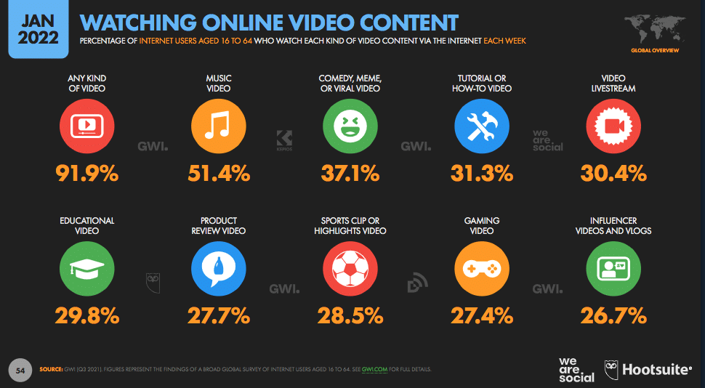
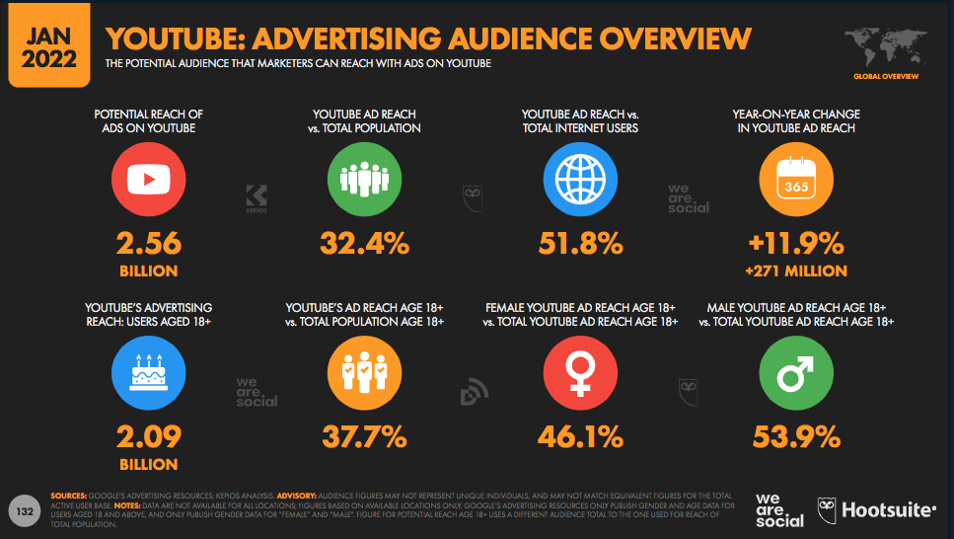
YouTube
INNOVATION & DISRUPTIVE INNOVATION
INNOVATION
User-generated Content
Localization and Globalization
Native Advertising Platform for Businesses
New Business Models
DISRUPTIVE INNOVATION
Video Monetization
Democratization of Media
PLETHORA OF PROFILED CONTENT CATEGORIES
AD REACH OF YouTube
Disruption of Traditional Way of Television Broadcasting

Slide 16

YouTube
PRODUCT ROADMAP
2006
2011
2012
2018
2018
2024
Features
Video uploading
Video Discovery and Interaction
Partner Program
Monetization
Added “Related Videos”
YouTube Live
YouTube algorithm
Creator Studio
Kids
Super chat
Premiere
Story
VR
Shorts
Sound video & creative effects
360-Degree Video Support
VR Rooms
Parental Control functions
Native 4K HDR
Hyper Smart device integration
Milestones
Signs contracts for original content
Next News Network Acquisition
Some kind of new innovation
Broke into new market (such as with YouTube TV
Vidmaker, Subarctic Bandpage Acquisition
4k Video Support
YouTube Spaces launched
1 Billion Monthly users
Additional 50 Billion daily views
Simsim Acquisition for E-commerce in India
230.6 Million Active monthly users
5.5 Million paid subscribers
Impacts
48 hours of videos uploaded every minute
Top video sharing platform – 5.2 hours per viewer per month
YouTube Creator Award
YouTube Creator Academy
Algorithm revised for stricter policies
YouTube crossed 15 billion revenue
8 billion revenue
Increased Parental supervision
Realtime user interactions
34% market share in vMVPDS market
Notes:
More on acquisition – Harish
Logos on the bottom – Harish
2006-2011 – Fan & Ishika
2012-2018 – Shubham & Zohaib
2018-2024 – Harish
First 1 billion-hit video (2012)

Slide 17
YouTube
VALUE CREATION
Users
2 Billion Viewers daily(Second largest)
70% of YouTube viewers use the platform to solve a problem related to their work, studies, or hobbies.
User -> Search & Viewing habits ->Algorithm ->70% Time spent
Space to soft launch Business
Global Recognition
YouTube partner program -> advertising revenue ->Monetization (increased by 40% YoY.)
Global reach, community engagement, and Brand Sponsorships
YouTube Analytics
In Q3 2021, > $30 billion (Over 3 years)
Creators
Stake
holder
YouTube ->major source of revenue for Google( Q3 2023 -> $7.2 billion in advertising revenue, > 83% 2022)
In Q3 2021, YouTube > 54% increase in the number of advertisers running TrueView for action ads
Notes:
YouTube Space - Zohaib

Slide 18
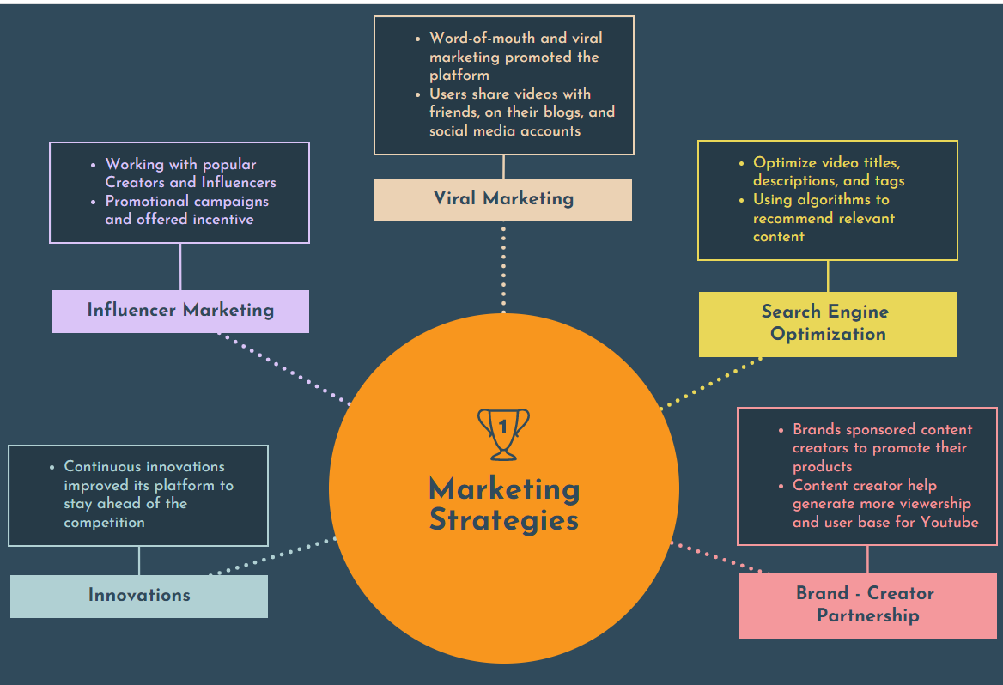
YouTube
MARKET STRATEGY
MARKET STRATEGY
Viral Marketing
Search Engine
Optimization
Influencer Marketing
Brand – Creator
Partnership
Innovations

Slide 19
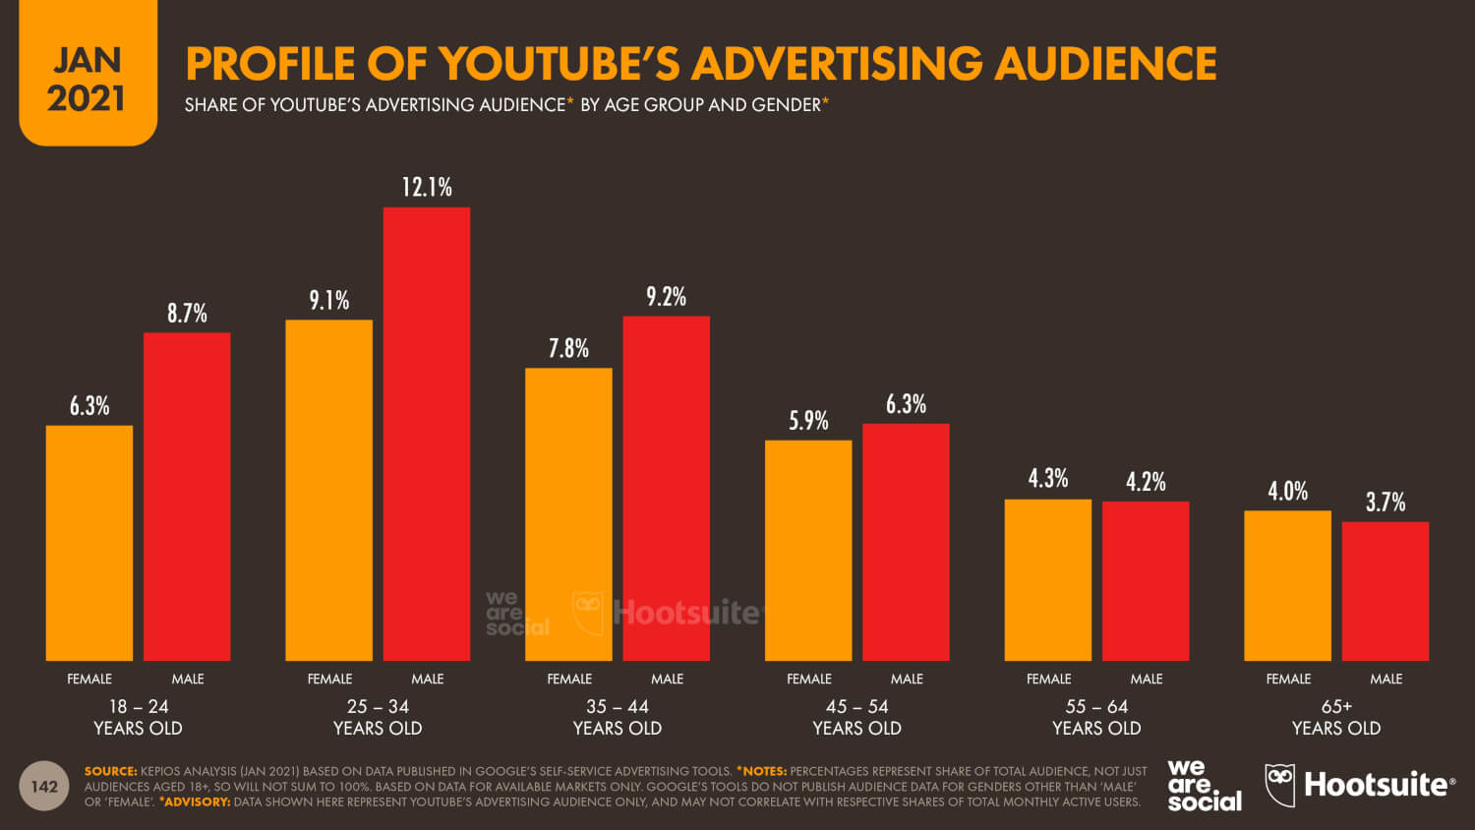
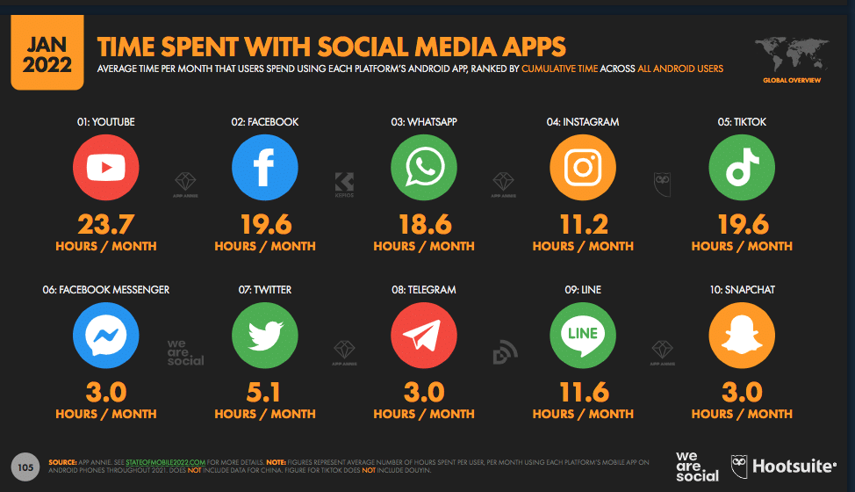

INNOVATION TO THE PRODUCT IDEOLOGY AND STATISTICS
PLETHORA OF PROFILED CONTENT CATEGORIES
AD REACH OF YouTube
PROFILE OF YouTube AUDIENCE
TIME SPENT WITH SOCIAL MEDIA APPS PER MONTH

Slide 20
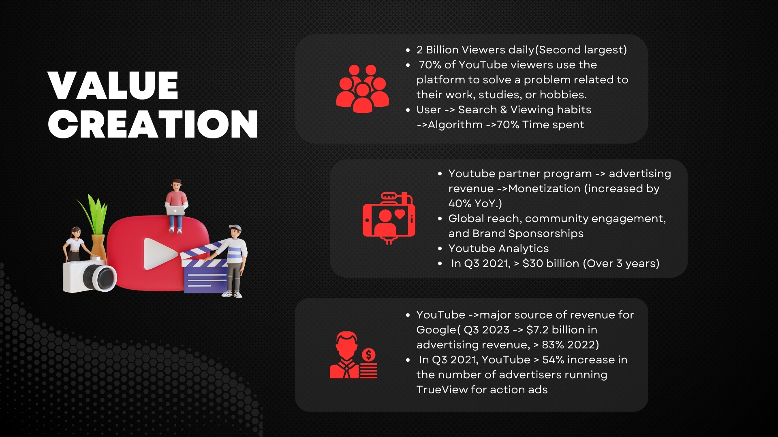

Slide 21
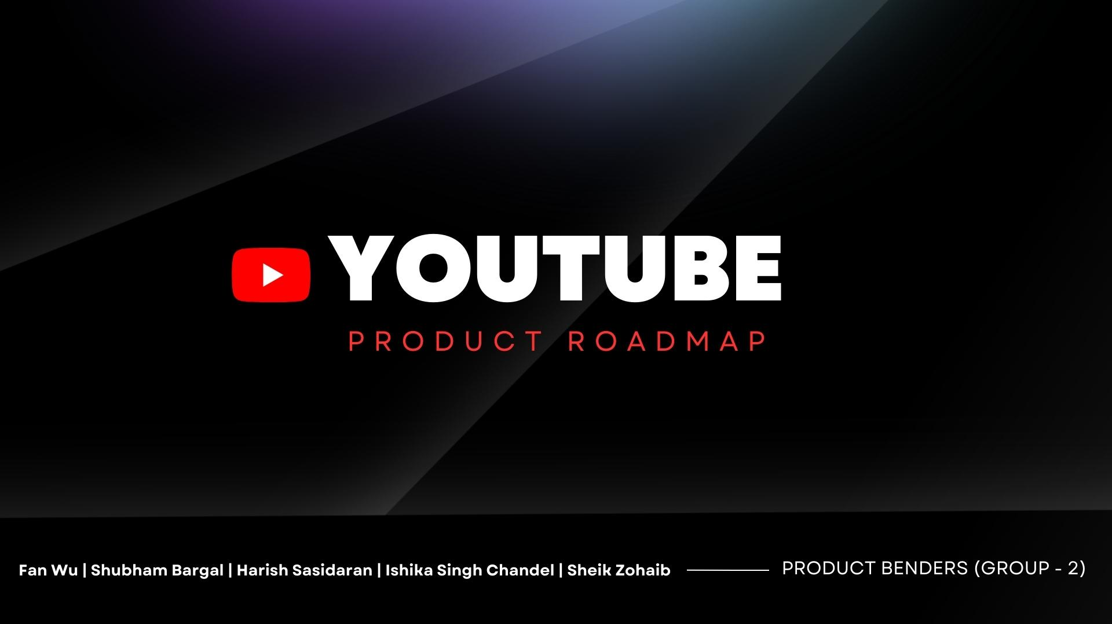
YouTube Product Roadmap
PRODUCT BENDERS (GROUP - 2)
Fan Wu
Shubham Bargal
Harish Sasidaran
Ishika Singh Chandel
Sheik Zohaib

Slide 22
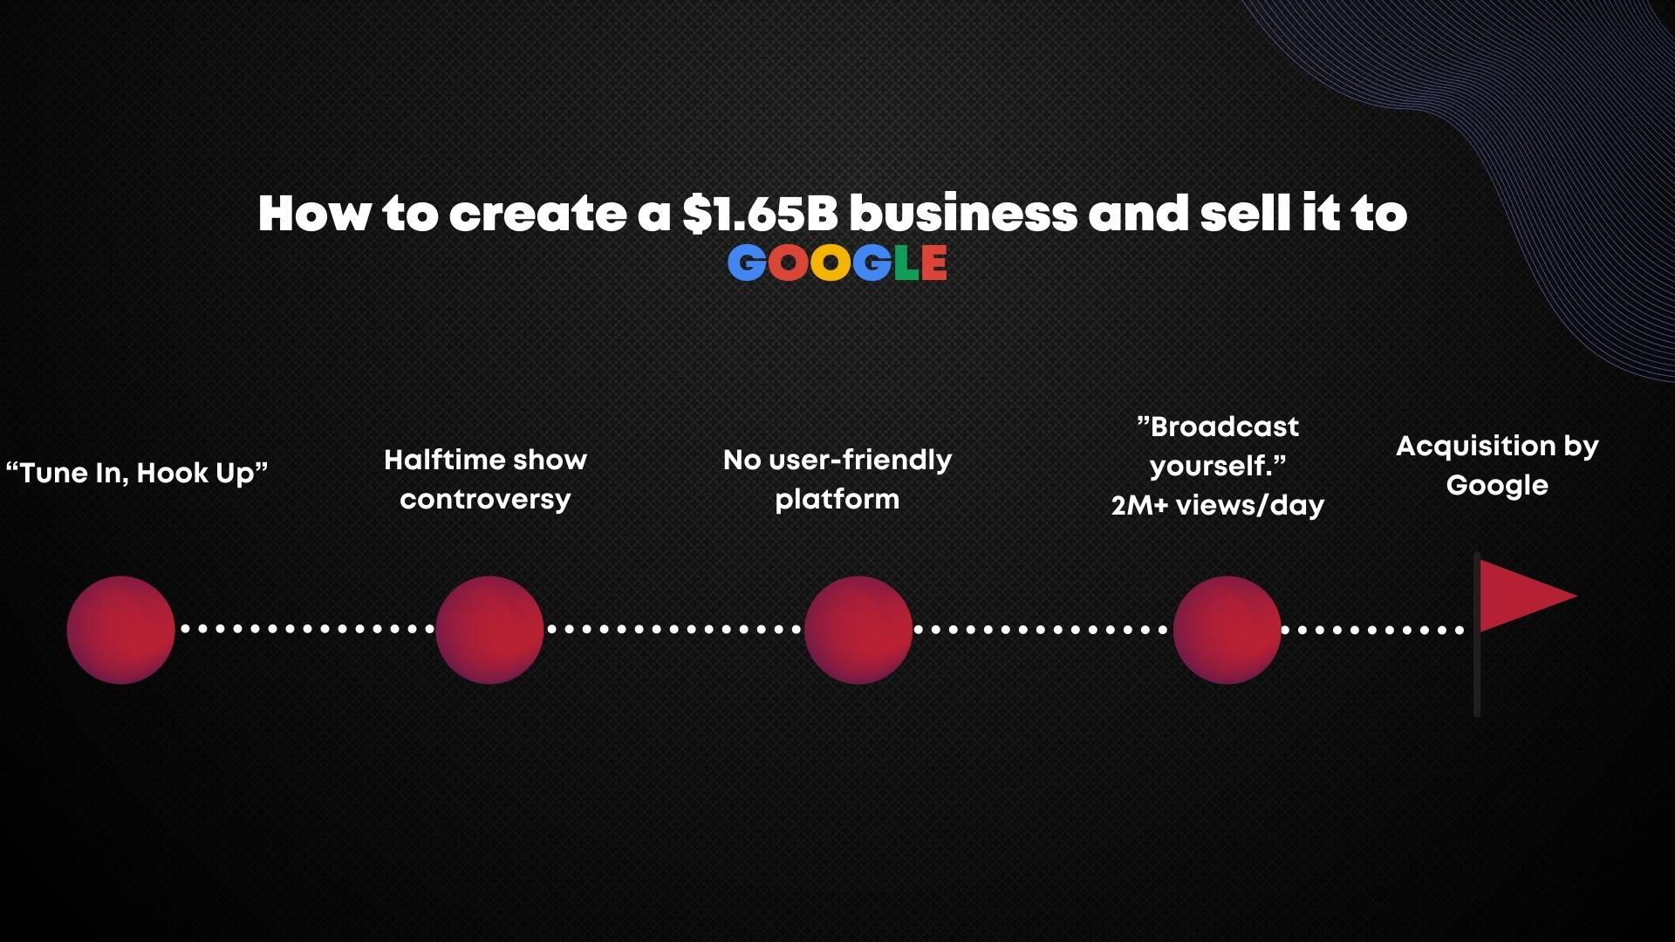

Slide 23









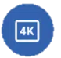


Product Roadmap
2005-2011
2012-2018
2019-2024
Video Uploading, Sharing, and Discovery (2005)
YouTube Creator Studio (2012)
YouTube Shorts (2018)
YouTube Video Monetization (2007)
YouTube Kids (2014)
YouTube VR Expansion (2022-24)
YouTube Premium ( Now YouTube Red) (2014)
YouTube TV 4K (2022)
YouTube Partner Program (2008)
YouTube Kids Supervision Mode (2022)
YouTube Live (2011)
YouTube Gaming (2015)
YouTube Algorithm (2011)
YouTube TV
(2016)

Slide 24
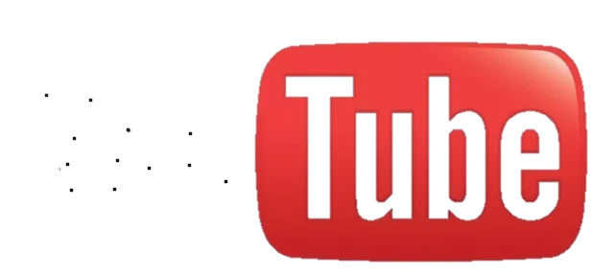




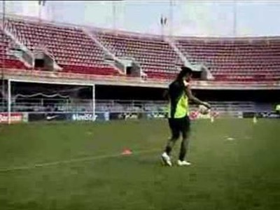

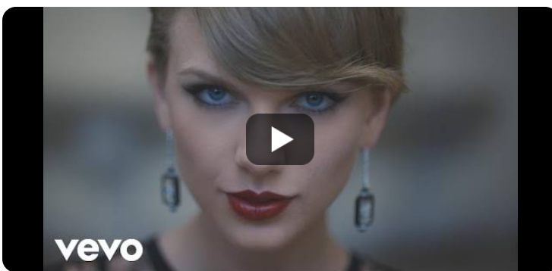
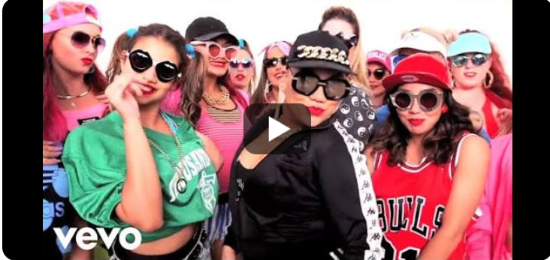
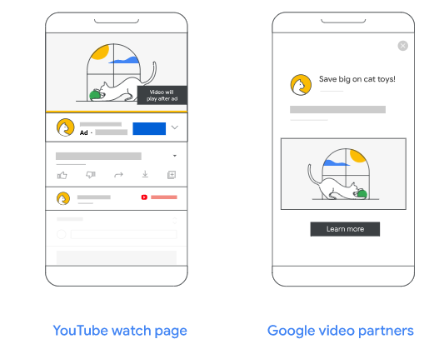
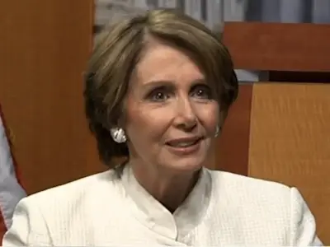
Product Roadmap Milestone
2005-2011
2011-2013
2013-2015
2015-2017
2017- Today
2005:In October YouTube gets its million-hit video
2011:YouTube reaches three billion video views
2012: Psy's 'Gangnam Style' becomes the first-ever YouTube video to hit one billion views
2013: YouTube reaches 1 billion unique monthly visitors
2014:Taylor Swift's 'Blank Space' becomes the fastest-ever video to hit one billion views
2015: Adele's 'Hello' becomes the first video to hit one billion views in just 87 days
2016: Justin Bieber's 'Sorry' becomes the fastest-ever video to hit two billion views
2017: Wiz Khalifa and Charlie Puth's 'See You Again' becomes the most-viewed video on YouTube
2018: Starts ad pod testing on YouTube
2019: YouTube unveils Video Reach platform
2018: Starts ad pod testing on YouTube
2022: YouTube is ranked as the second most popular social network worldwide
2009:111th U.S. Congress launches official Congressional YouTube channels.
YouTube reaches 1 billion video views per day.
2010:YouTube reaches two billion video views per day and launches Live

Slide 25
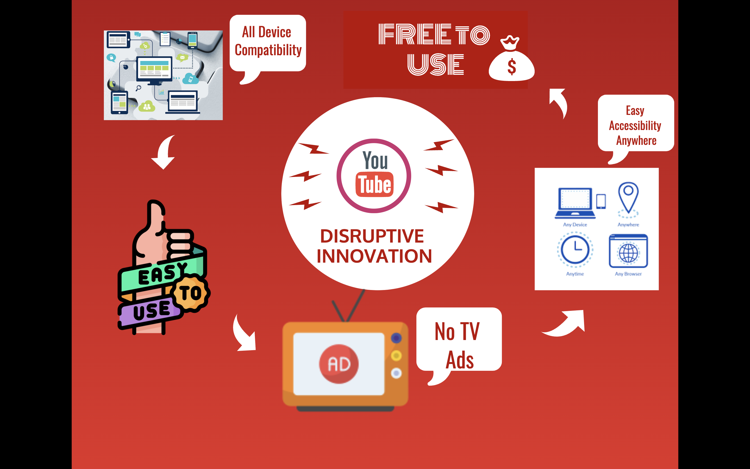
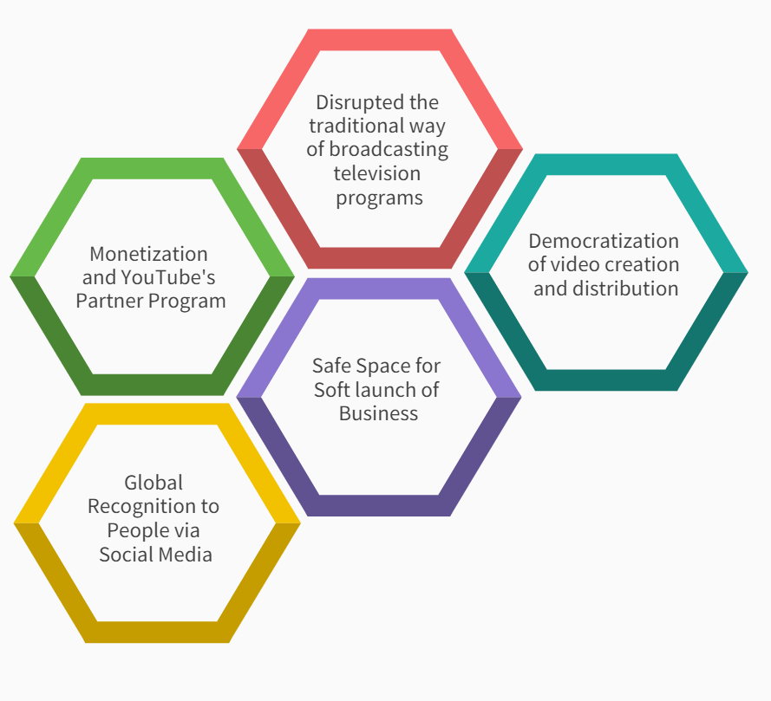
DISRUPTIVE INNOVATION

